Slide 1
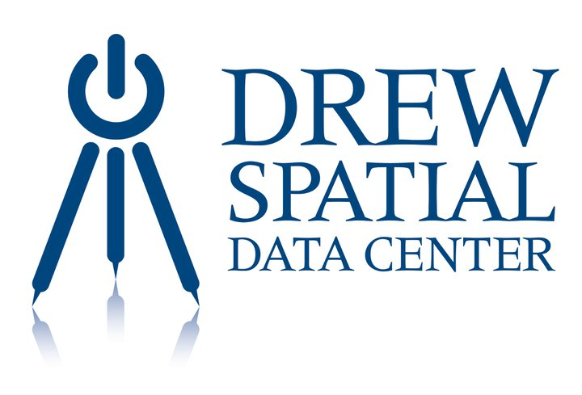
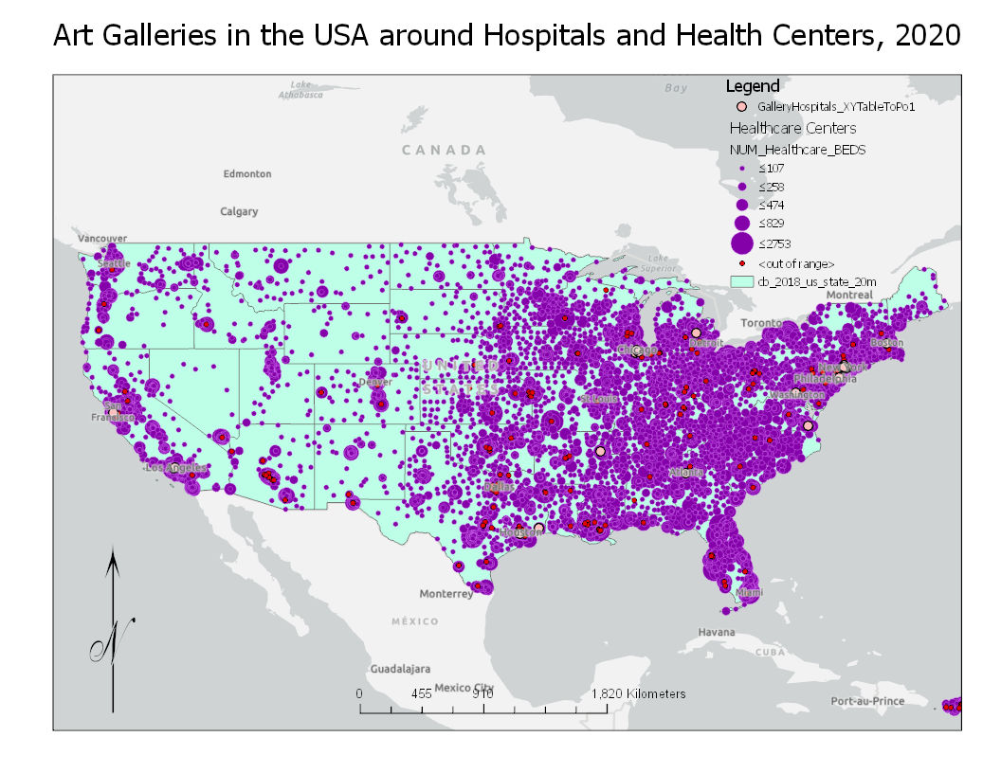
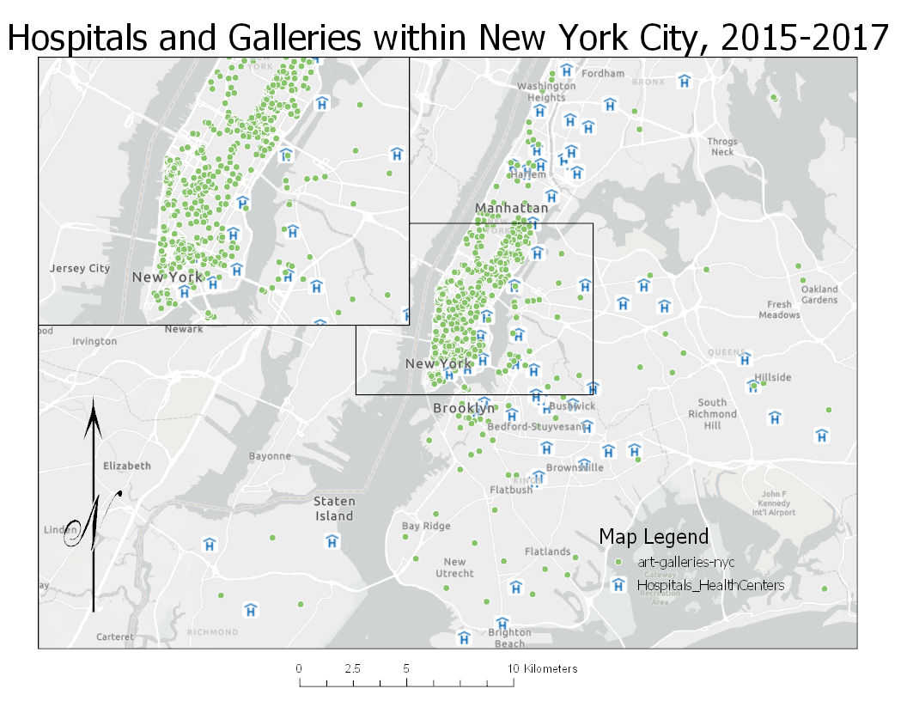
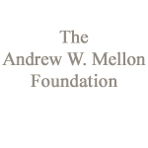
Art Galleries Near Hospitals 2015-2017
Introduction
Results
Art has been seen in various formats in multiple locations all over the world. Art has mostly due to these formats, art has not been taken as seriously as other subjects, however with recent studies preformed in labs, it has shown differently. The studies have included a table of results that conclude how art distracts a persons mind from the bad and provides a positive outlook that can change a person’s mindset, thus allowing healing to proceed faster (Stuckley 2010).
This has been rumored but with studies provided it is easier to look upon. Based on NYC I estimate that there are numerous galleries surrounding hospitals and treatment centers.
Within the US, there were not as many galleries seen in rural areas as seen within the major cities of each state. NYC for instance had a multitude of galleries not including organizations that send donations of money and art to the health centers. NYC seemed to have the hospitals and health centers that were identified surrounded by art galleries.
Conclusions
Hospitals clearly in certain areas outnumber the count of galleries but if heading closer towards the city the opposite occurs. With more people located within the city limits, more galleries are to open and help out through people’s mindset.
The mind has been proven time and again how strong it can be and through positive reinforcement, such as art, healing can be completed faster in a safer way.
Figure 1: Art Galleries around Hospitals and Health Centers within the US up to 2020. The Hospitals are presented within the purple circles with the bigger sized representing more within that area. The pink circles represent RxArt locations as Galleries in all states were hard to come by.
Data
The data being utilized is from RxArt organization’s locations within hospitals and maps created and uploaded to ArcGIS data base that have been uploaded to both maps (RxArt 2020).
The organization is current up to 2020 while the galleries in NYC is 2015 and hospitals listed is 2017.
Bibliography
Methods
[1] "RxArt," 2020. [Online]. Available: rxart.net.
[2]H. L. Stuckey and J. Nobel, "The Connection Between Art, Healing, and Public Health: A Review of Current Literature," American Journal of Public Health, vol. 100, no. 2, pp. 254-263, February 2010.
[3] A. Portal, "ArcGIS," 2015-2020. [Online].
To achieve the results of art galleries surrounding hospitals and health centers the data was obtained and placed into the map.
The maps were created by the following:
Map was created
Galleries within NYC was added to the current map
Hospitals and Health centers was searched and added to the map to
Layout was created to show the galleries around hospitals
For the US state boundaries were added with both hospitals and galleries shown with the same data on another map layout
Figure 2: Art Galleries around Hospitals and Health Centers within New York City in 2015-2017. The area surrounding NYC is also shown to demonstrate how far the galleries range(green dots). The city itself is highlighted within the zoomed in box with numerous shown surrounding the hospitals.
Author, Contributors:
Natalie Johnson
Map created 12/10/2020

