Slide 1
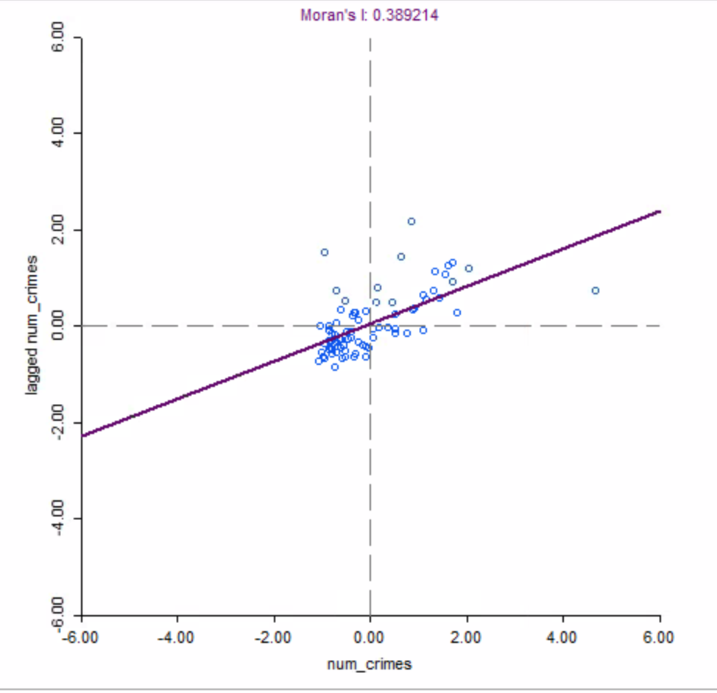
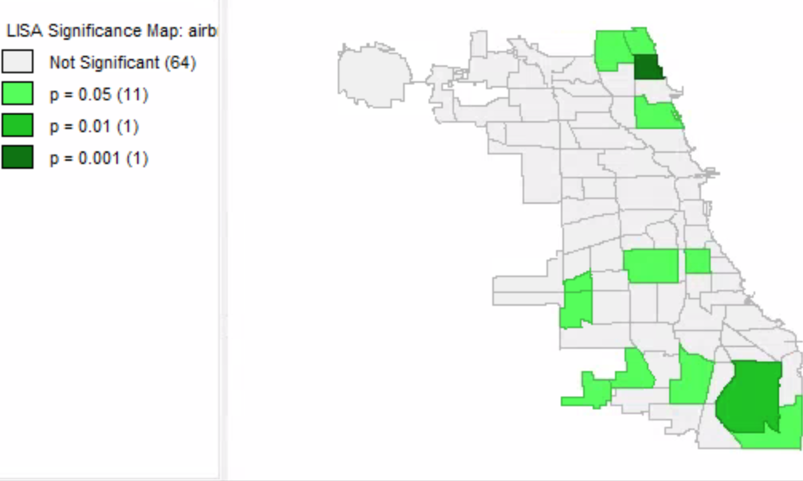
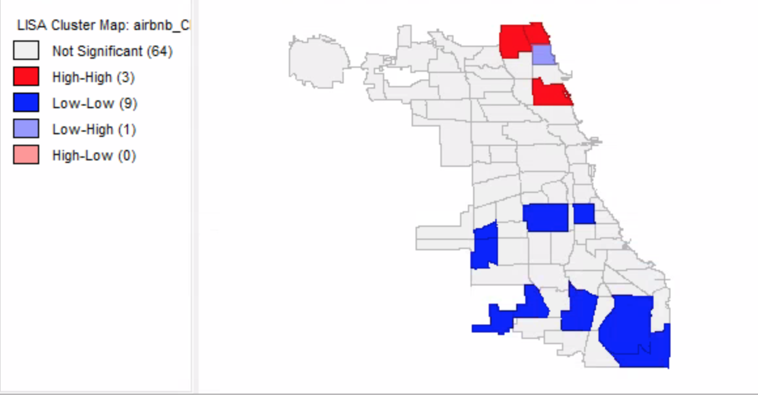
Spatial Clustering of Crime in Chicago, Illinois in 2015
Figure 1: Lisa significance Map for Airbnb crimes. The green areas highlight the areas that have low to high significance which includes 13 different areas within Chicago. Dark green having the smallest while the light green has the highest.
Within the Significance graph areas where the highest mathematical significance and lowest are since it is calculated by equations based on data collected. However given that this was five years ago the data for this year has changed in addition to everything that has occurred within the past 6 months.
In 2015 there was a collection of data that lead to to crimes within Chicago, Illinois that include but are not limited to battery, burglary, gambling, robbery, stalking, homicide, and left.
This occurrence is recorded from October 2014 to September 2015 right before the data was collected for the AirBnb was created within the city.
The clustering of Crimes within the city showed low clustering of crimes. The Moran’s I Value was indicated as 0.39.
Figure 2: Lisa cluster map for Airbnb crimes in Chicago. Here it is categorized with high numbers and high numbers being bright red and low-low numbers being bright blue. The same areas are highlighted that were highlighted in the previous figure.
Data Source: Data Prepared by Rodrigo Valdes. Last updated July 10, 2017. Data provided “as is,” no warranties.
Data from: https://data.cityofchicago.org/view/5cd6-ry5g
When looking upon the Cluster map, the areas tend to group together with the highest and lowest crime average, of course with below average. The below average, low-high values are only represented in one area highlighted in light blue. Most areas that are highlighted tend to be low-low, where the average is met but low.

