Slide 1
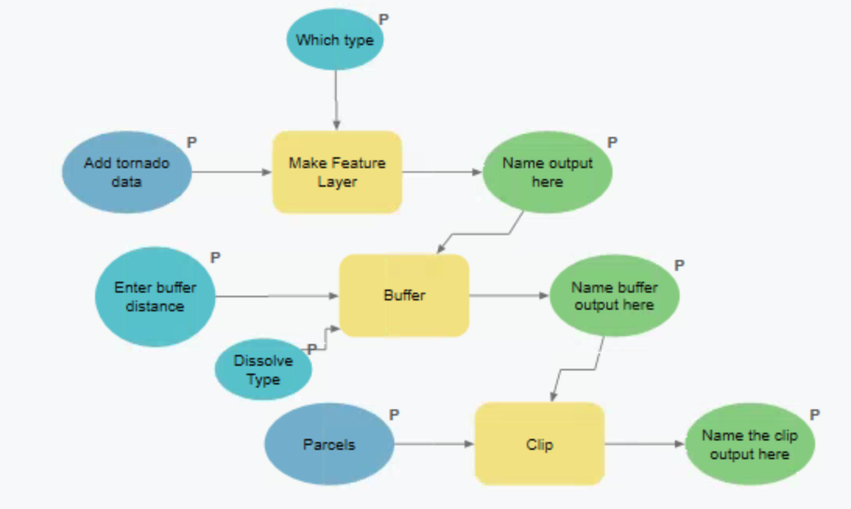
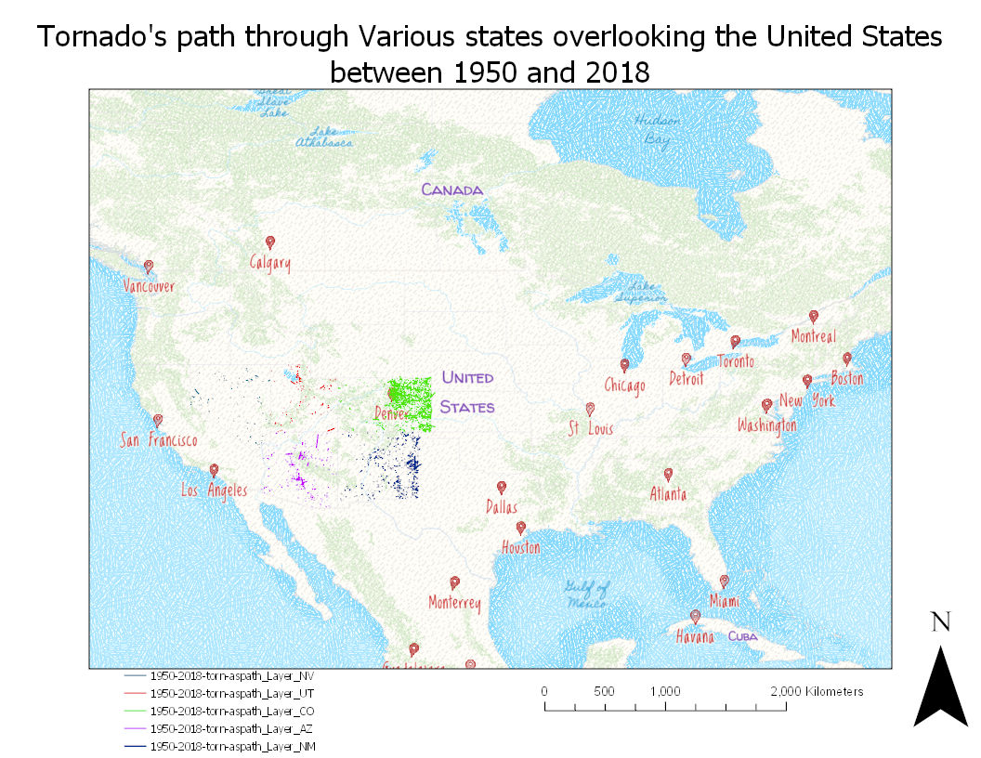
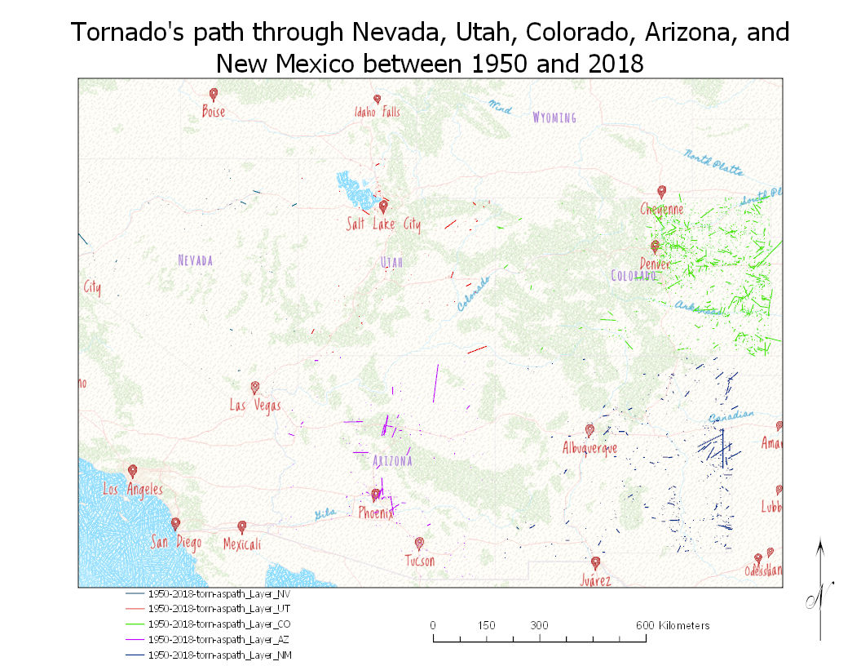
Exploring the Number of Tornados in Farmland states in the U.S.
Introduction
Conclusions
Tornadoes are fairly rare events, but have been an interesting topic for years. Movies have been created to showcase this natural phenomenon, such as twister which gives this idea of many tornados within the middle of the country where there are plenty of open space. As a result, certain states were chosen to see just how true the idea of tornados among these states is.
The NOAA SVRGIS database is useful not only for larger regional analyses allotting one to look upon many states at one time, such as NV, NM, CO, AZ, and UT.
By combining tornado tract information, buffer analysis, and clip processes, it is possible to identify specific locations and the amount of tornados within certain areas. There seemed to be more towards the, “exact” middle of the country than there were more towards the west coast. Thus showing that CO had the most tornados than any other state highlighted.
Future work might explore automating the steps displayed in this exercise to see how much of an impact these tornados did to each individual state resulting in the highest and lowest impact.
Data
Figure 1 (above): Visual Diagram of Model and Processes. The model was transformed to allow choosing data from various states, parameters and the name of each outcome layer from feature layer to parcel/clip layer.
Figure 2a: Overall map of the United States with the five states location easily seen.
Figure 2b: A close-up of the five states whose tornados were looked at during 1950-2018. The close-up of the states allows one to see just how many tornados have hit to easily compare between the states.
Data on tornado tracts were obtained from the NOAA Storm Prediction Center, SVRGIS page. Attributes included: date, time, length, width, and start and end locations.
Methods
To explore the impact of this particular tornado, the following steps were completed:
Model from assignment 15 in ArcGIS Pro was adjusted to allow for choosing tornado data and names of output along with other valuable data (see Figure 1).
Five states were chosen, NV, NM, CO, UT, and AZ from the NOAA SVRGIS database (1950-2018).
The five states had names corresponding to their states for each layer (buffer, clip) and the program was run.
The map of the overall and close up states were set-up on a layout to be easily seen.
Bibliography
ESRI. 2019. ArcGIS Pro: Model Builder. Redlands, CA.
NOAA. 2019. NOAA Storm Prediction Center: Severe Weather GIS Data Page. D
Figure 2a
Results
Figure 2b
Natalie Johnson
10 November 2020
I determined that these states specifically do not contain as many tornados as many might think as they see less one nears the west coast.

