Slide 1
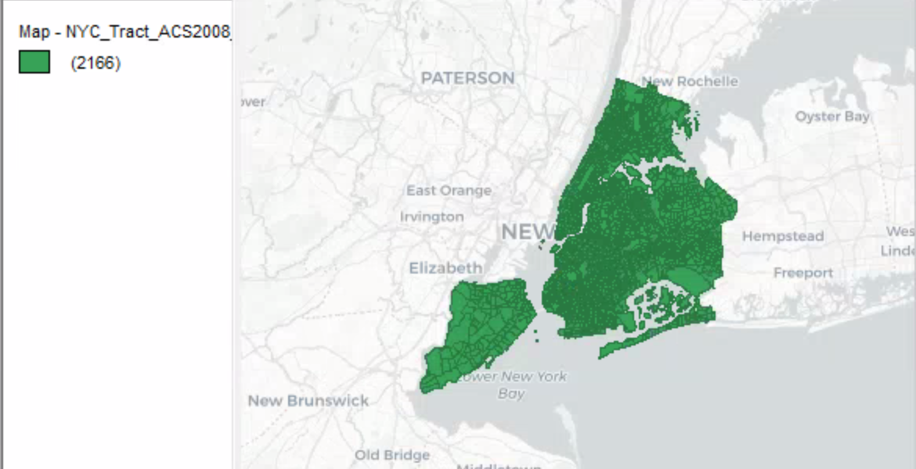
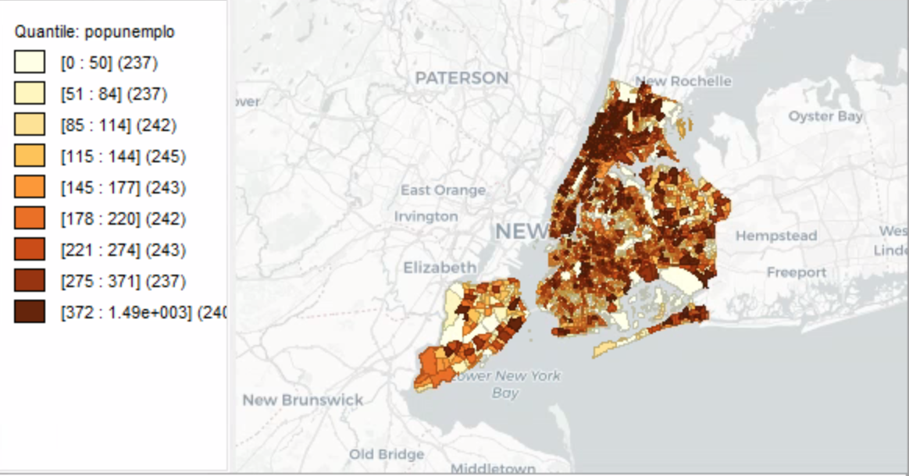
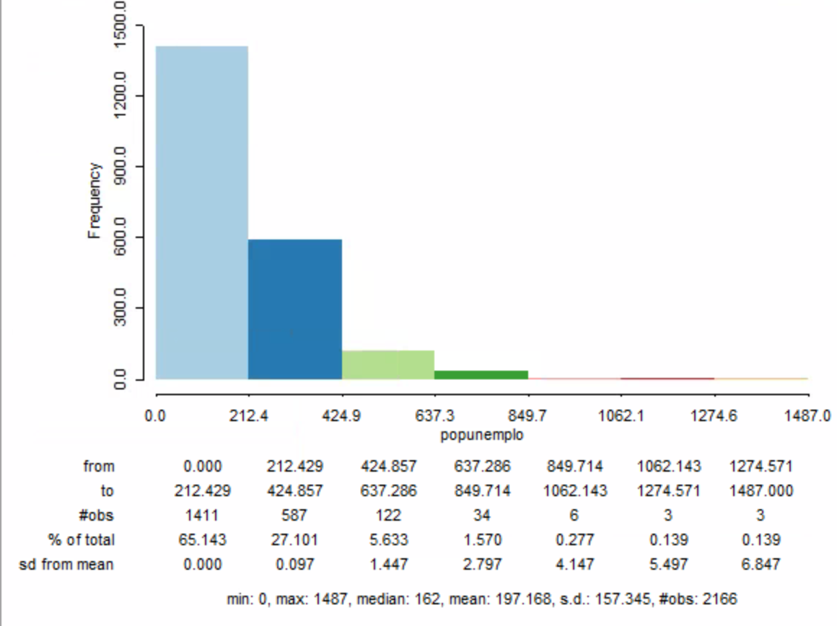
New York City Demographics During 2008-2012
Introduction
There have been more applications available as technology advances. GIS has commonly used ArcGIS Pro and their online databases to explore demographics, maps, and many more avenues. GeoDa is another application that was used for this project to explore data a different way. Here, New York City’s demographics is being observed with 2166 selected and further investigation into the total unemployment count of the population.
Results
Methods
Conclusion
The results of the data showed high amounts of people unemployed within each part of the city. The histogram and map showed areas with high unemployment further from the major part of the city
The data was downloaded from GeoDa’s website for NYC demographics along with the corresponding application. The data was placed into the application and new maps were created off of the original map above, total population unemployment and the histogram.
The data analyzed gave a new perspective on unemployed people within the city’s limit. The closer to the major part of the city the medium amount of people unemployed. Whereas the parts that have more employed population is closer to upstate New York.
It was also interesting to see that Staten Island was included as NYC.
Data
The data was achieved through GeoDa website with data sets downloadable from cities ranging from Chicago to NYC using US Census Bureau.
Figure 1. Total unemployment in NYC demonstrating 9 quantiles with different ranges.
Figure 2. Histogram of total unemployment with standard deviation and frequency.
Data Source: American Community Survey 2008-2012, US Census Bureau.

